Slide 1
ADS:lab session #2
24, August 2015
Kamil Salakhiev

Slide 2
Time estimating in machine
Machine measures time in 2 ways:
For itself, by counting ticks
For humans, by converting ticks to date/time with taking into account leap years, leap seconds, coordination shifts (Kazan +3hrs) and network protocol for auto correlation

Slide 3
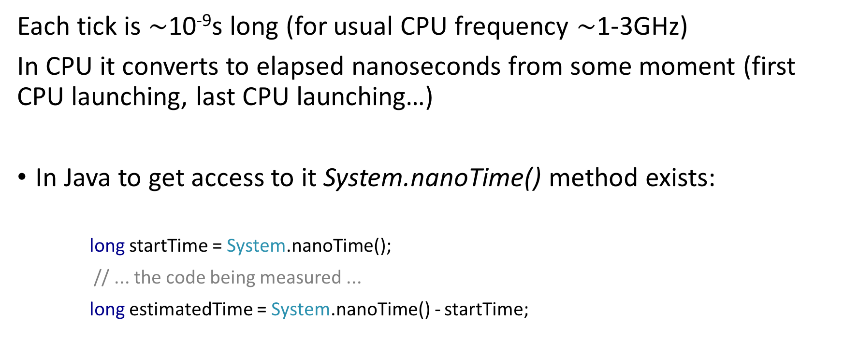
What about Java
Each tick is $\sim$10⁻⁹s long (for usual CPU frequency $\sim$1-3GHz)
In CPU it converts to elapsed nanoseconds from some moment (first CPU launching, last CPU launching…)
In Java to get access to it System.nanoTime() method exists:
long startTime = System.nanoTime();
// ... the code being measured ...
long estimatedTime = System.nanoTime() - startTime;

Slide 4
Another method
Another way to calculate elapsed time is System.currentTimeMillis() method:
long startTime = System.currentTimeMillis();
// ... do something ...
long estimatedTime = System.currentTimeMillis() – startTime;
Why long?

Slide 5
Storage estimating
Storage refers to the data storage consumed in performing a given task, whether primary (e.g., in RAM) or secondary (e.g., on a hard disk drive)
In Java to estimate consumed memory there is a Runtime.getRuntime().totalMemory() method, that returns the total amount of memory currently occupied for current objects measured in bytes:
long start = Runtime.getRuntime().totalMemory(); System.out.println("start = " + start); // prints 64487424 int arr[] = new int[100000000]; long finish = Runtime.getRuntime().totalMemory(); System.out.println("finish = " + finish); // prints 464519168

Slide 6
The RAM model of computation
The RAM model of computation estimate algorithm according the following rules:
Each simple operation (+, *, –, =, if, call) takes exactly one time step.
Loops and procedures are not considered as simple operations.
Each memory access takes exactly one time step
Example:
for (int i = 0; i < n; i++) { x++; }
Takes n steps

Slide 7
Big O notation
In Big O notation we are interested in the determining the order of magnitude of time complexity of an algorithm

Slide 8
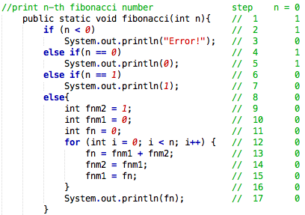
Calculate n-th Fibonacci number (n = 0)
Number of steps: 5

Slide 9
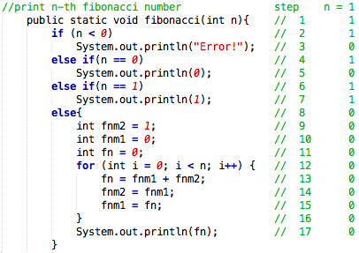
Calculate n-th Fibonacci number (n = 1)
Number of steps: 6

Slide 10
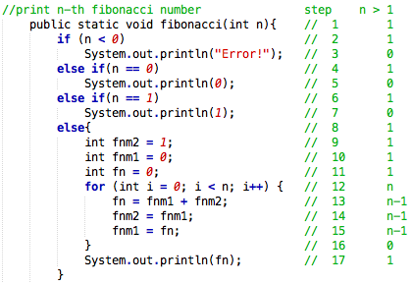
Calculate n-th Fibonacci number (n > 1)
Number of steps: 9 + n + 3(n-1) = 4n + 6

Slide 11
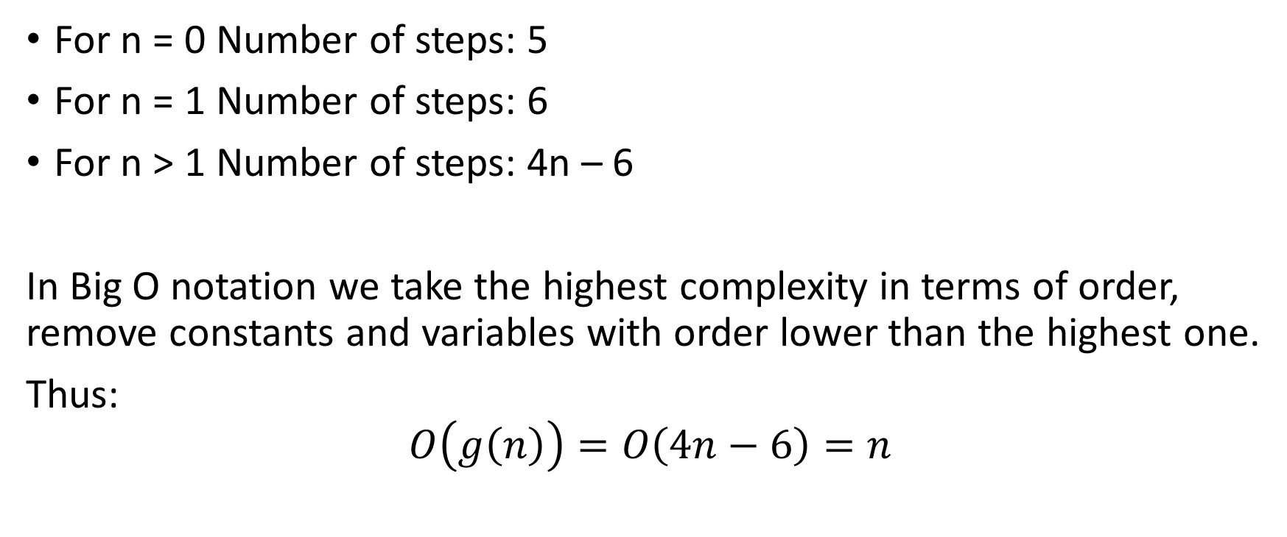
Fibonacci number
For n = 0 Number of steps: 5
For n = 1 Number of steps: 6
For n > 1 Number of steps: 4n – 6
In Big O notation we take the highest complexity in terms of order, remove constants and variables with order lower than the highest one.
Thus:
$$O\left(g\left(n\right)\right)=O\left(4n−6\right)=n$$

Slide 12
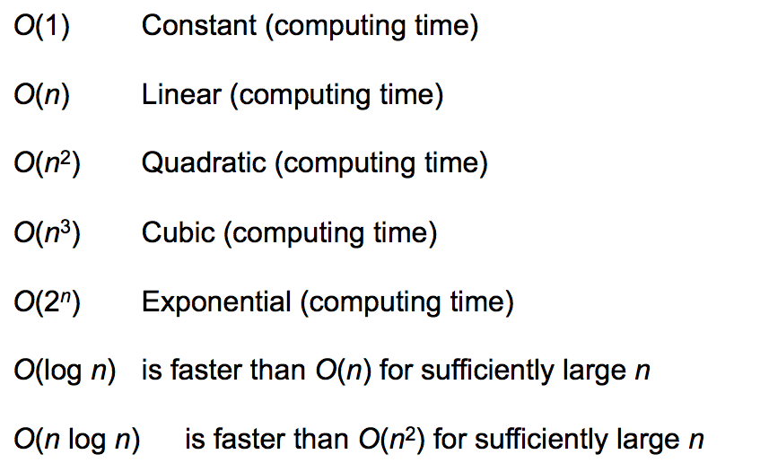
Time complexities

Slide 13

More examples
$O\left(2^{n+1}\right)=2^{n}$
$O\left(2n^{2}+4n+10\right)=n^{2}$
$O\left(n\log{n}+n\right)=n\log{n}$
$O\left({10n}^{3}−5n^{2}+3n−1\right)=??$
$O\left(n\sqrt{n}+n^{2}\right)=??$
$O\left(n\sqrt{n}+n^{2}\right)=??$
$O\left(n!+2^{n}\right)=??$

Slide 14
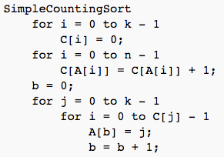
Counting sort
For array A with size n, where upper possible element equals K algorithm is the following:
Sample output:
n = 20
k = 25
A = 12 2 22 24 22 14 6 18 10 6 3 13 17 5 8 13 24 12 22 19
C = 0 0 1 1 0 1 2 0 1 0 1 0 2 2 1 0 0 1 1 1 0 0 3 0 2
A = 2 3 5 6 6 8 10 12 12 13 13 14 17 18 19 22 22 22 24 24

Slide 15
Task #1
Implement “counting sort” that sorts an array of integers
Use Math.Random() or r.nextInt(k) to fill array where K is data value upper limit. Let K = 10000
Implement time measurement for the algorithm. Measure time using System.nanoTime() for array size of 100, 1000, 10000, 100000, 1000000 elements in array.
Vary K from 10000 to 100000 find the dependency of how it affects time consumption
*Extra task. Implement counting part of counting sort in parallel. Compare results

Slide 16
Optional homework
Make a report of done work in LaTex:
Function graph of time/size(K) (memory)
Your code (use package: listings)
Your computer configuration: Processor, number of cores, frequency
Comparison with parallel sorting - vary number of threads.
Discuss the performance, your ideas

